Slide 1


Final Year Project
AI EYE GUIDE FOR VISUAL IMAPIRED PERSON
Supervised By: Ihtisham Ullah (Lecturer)

Slide 2
Project Team
Usama Ahsan (25279)
Muhammad Hassan (22956)
Suleman Amjad (24913)

Slide 3
Table of Content
Introduction and Background
Literature Review and Summary Table
Problem Statement
Endeavour
Progress Report Summary
Requirements
Software System (Design + Implementation + Testing)
Endeavour (Team)
Next Steps
Prototype / Report

Slide 4
INTRODUCTION AND BACKGROUND

Slide 5
Introduction and Background
We are creating an application for visually impaired person to make their lives easier with the use of latest technologies
In the world, there are more than 2 billion people are visually impaired
Over user friendly interface will ensure that everyone can effortlessly access and enjoy the features of our application

Slide 6
Literature Review and Summary Table
 | Author | Domain | Date | Reference
1 | Ranjeet.P, Rahul Modi, Avinash.P, Ms. Jyoti B. Deone | Designing Mobile Application for Visually Impaired Person | 8, April, 2022 | https://papers.ssrn.com/sol3/papers.cfm?abstract_id=4108763

Slide 7
Summary Table
Apps | NoteTaking | Voice- Recorder | Speech- to- Text | AudioBook- Listening | Camera Translation | Accessible Documents sharing
AccessNote | ✓ | ✓ | ✖ | ✖ | ✖ | ✖
Dragon Dictation | ✖ | ✖ | ✓ | ✖ | ✖ | ✖
EverNote | ✓ | ✓ | ✓ | ✖ | ✖ | ✖
Kindle | ✓ | ✓ | ✖ | ✓ | ✖ | ✖
Google Translate | ✖ | ✖ | ✓ | ✓ | ✖ | ✖
Money Detector | ✓ | ✖ | ✓ | ✖ | ✓ | ✖
Object Detection | ✖ | ✖ | ✖ | ✖ | ✓ | ✖

Slide 8
Problem Statement
Visually impaired individuals face daily obstacles, such as accessing printed and digital information, understanding unfamiliar objects, and identifying currency banknotes.
These challenges can block their independence and access to education and employment opportunities.

Slide 9
Endeavour
Usama Ahsan (Currency detection + Feed back + Data collection + Integration + Frontend)
Muhammad Hassan (Object detection + Report writing + Data collection + Testing + Test cases)
Suleman Amjad (Document reading + Report writing + Data Collection + Testing)

Slide 10
PROPOSED SOLUTION

Slide 11
Proposed Solution
The solution we proposed we gathered the difficulties in the life of visually impaired persons to improve their lives. We checked the needs of these people and implemented in our application.
Key modules:
Currency detection
Object detection
Document reading
Feed back

Slide 12
Requirements(1/4)
Functional Requirements
Object detection
Currency detection
Text to voice
Feedback

Slide 13
Requirements(2/4)
Non-Functional Requirements
Usability
Reliability
Performance
Scalability
Accessibility

Slide 14
Requirements(3/4)
List of Different Users
Visually impaired person

Slide 15
Requirement(4/4)
Android Device: Any modern android smartphone with sufficient processing power and storage space to run the application smoothly
Processor: Minimum dual-core processor for optimal performance.
Memory (RAM): At least 2GB of RAM to ensure smooth operation.
Storage: Adequate internal storage space to install the application and store user data.

Slide 16
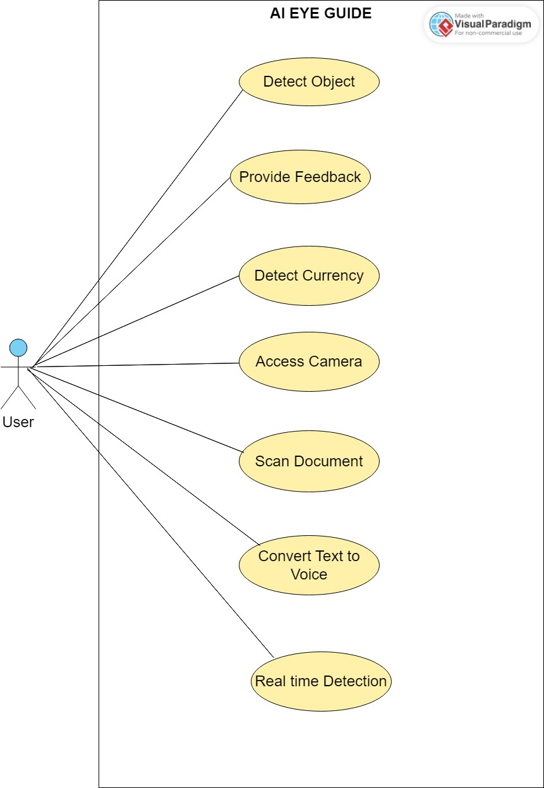
Design Summary
Use Case Diagram
Sequence Diagram
Ref> 3.6 Sequence Diagram
Page 31-32 from Report
Class Diagram
Ref> 3.5 Class Diagram
Page 30 from Report

Slide 17
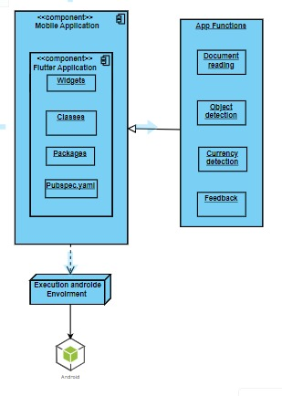
Methodology

Slide 18
Implementation
List Development Tools & Technologies
Android Studio
Visual Studio Code
GitHub
Microsoft Word
Microsoft PowerPoint
Google Colab
Pycharm

Slide 19
Implementation
List Best Practices / Coding Standards
Model View Controller Pattern
List Libraries / Components / Web Services
Flutter, Dart
Python, YOLO V8, RoboFlow, Open CV
Git

Slide 20
Experiments and Results Summary
User satisfaction survey was performed by graduated experienced persons but they were limited so we manually gathered the data.
Sr No. | Features | Excellent (%) | Good (%) | Average (%) | Poor (%)
1 | Object detection | 80 | 5 | 10 | 5
2 | Currency detection | 100 | 0 | 0 | 0
3 | Feed back | 95 | 5 | 0 | 0
4 | Document reading | 100 | 0 | 0 | 0
5
6

Slide 21
Testing Summary
Test case ID | Feature/Module
TC-01 | Object Detection Module
TC-02 | Currency Detection Module
TC-03 | Document Reading Module
TC-04 | Feed Back Module

Slide 22
Conclusion
Main accomplishment is that we were able to create the AI-based application for visually challenged people which is fully automated.
Our project aimed to develop an automated AI-based application for visually challenged people to fulfill daily activities

Slide 23
Thank You!!!

